Slide 1
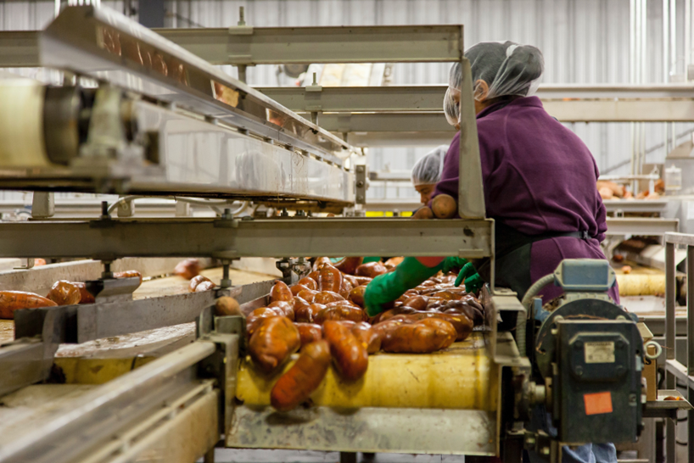
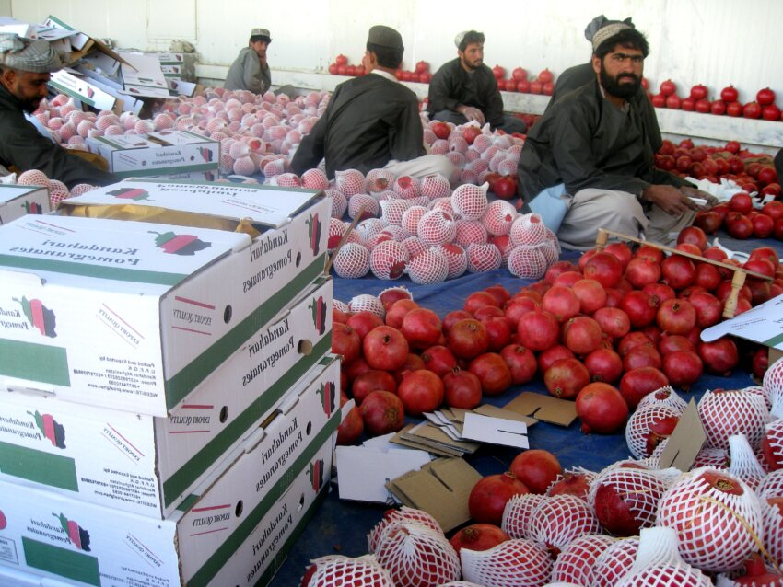
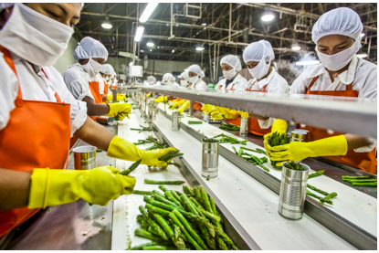
Food Processing Industry Finance

Slide 2
Agri Enterprises Loan (AEL)
1. Eligibility:
Proprietorship/ Farmer (Non-individual)
Partnership concerns,
Private Limited Companies,
LLPs,
Corporates,
FPOs.
2. Quantum of Loan:
Rs. 1 lakh - Rs. 100 crores.
(Aggregate sanctioned Limit should not exceed Rs. 100 Crores in the Banking system).

Slide 3
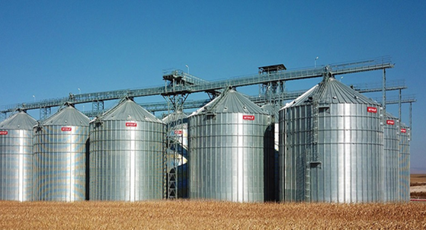
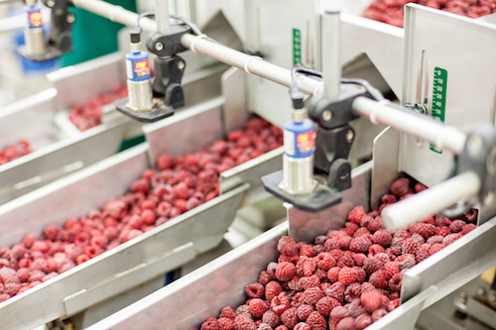
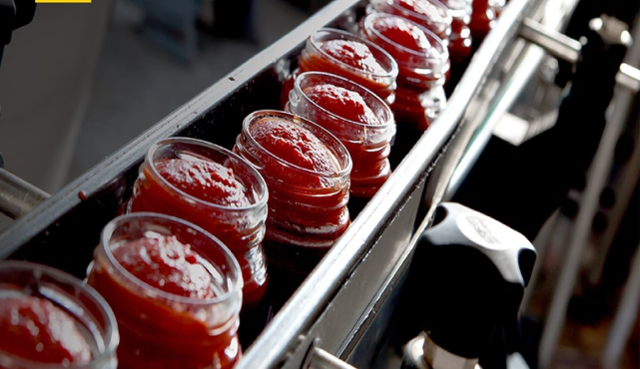
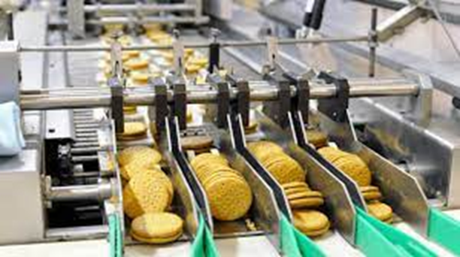
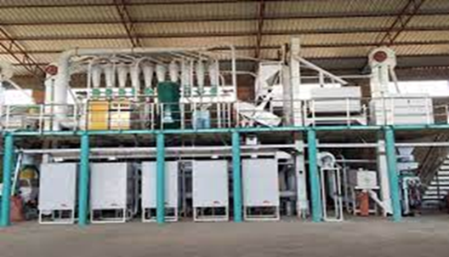
Agri Enterprises Loan (AEL)
3. Eligible Entity/Activity:
Agri Commodity Processing Units viz., Rice Mill, Dal Mill, Cotton Mill, Oil seeds processing, etc.
Food Processing Units involved in Fruits & Vegetables Processing, Grains/ Pulses Processing, Production of Jaggery and Nuts processing, etc.
Agri Exporters viz., Export of Fruits & Vegetable Dairy products, Spices and Oil, etc.
Agri Input Manufacturing Units engaged in Production of bio-pesticides, bio-fertilizers and biofuels, etc.
Farmer Producer Organizations.

Slide 4
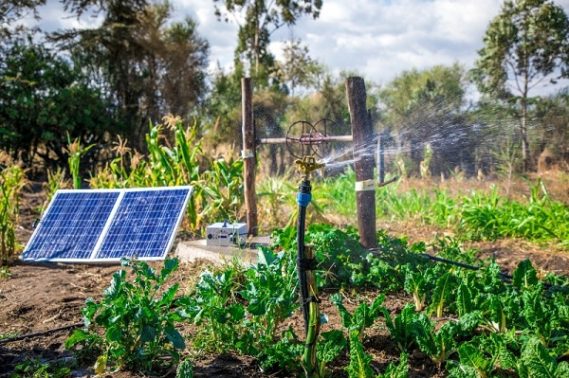
Agri Enterprises Loan (AEL)
3.1: Activities covered* :-
Construction of storage facilities (Cold Storage, warehouse, market yards, godowns and silos).
Construction of oil extraction/ processing units for production of bio-fuels, their storage and distribution infrastructure.
Cleaning, Air Cooling (Field Heat Removal), Sorting, Grading/Sizing, Packaging, Warehousing, Distribution of Fruits & Vegetables etc.
Transportation including in refrigerated van/ Cold Chain infrastructure system Packaging and storage.
Primary and/or Minimal Processing of Fruits & Vegetables (F&V). Sun Drying and Mechanical Drying.
Preservation through traditional and modern methods.
Frozen Products (Fruit, Vegetables, Meat, Fish, Sea Foods etc.)

Slide 5
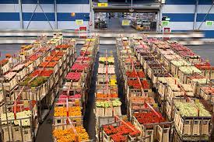
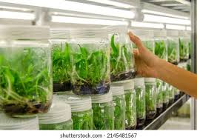
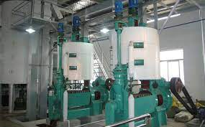
Agri Enterprises Loan (AEL)
3.2: Activities covered :-
Milk and Milk products processing, including their transportation, packaging and storage.
Canning of Fruit, Vegetables including Mushrooms, Meat, Fish, crustaceans, molluscs, other Sea Foods etc.
Milling Grains, Legumes & Pulses, Preparation of their by-products such as Bran Oil, Cattle Feed/Poultry feed etc.
Processing of F&V into different products such as juices, concentrates, jam, Chips, Flakes, Powders etc.
Oil seed Extraction- Rendering, Pressing, Hydrogenation, Refining with Extraction, Filling/packaging etc.
Production of Organic food products.

Slide 6
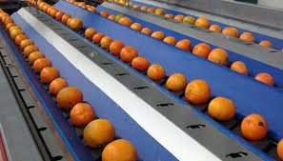
Agri Enterprises Loan (AEL)
3.3: Activities covered :-
Cleaning, Air Cooling (Field Heat Removal), Sorting, Grading/Sizing, Packaging, Warehousing, Distribution of Fruits & Vegetables etc.
Transportation including in refrigerated van/ Cold Chain infrastructure system Packaging and storage.
Primary and/or Minimal Processing of Fruits & Vegetables (F&V).
Sun Drying and Mechanical Drying.
Preservation through traditional and modern methods.
Frozen Products (Fruit, Vegetables, Meat, Fish, Sea Foods etc.)

Slide 7
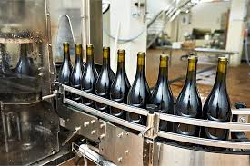
Agri Enterprises Loan (AEL)
3.4: Activities covered :-
Production of fermented Products and Alcoholic- Wines, Vinegar, Milk products, Prebiotics, Probiotics etc.
Production of beverages - Juices, Nectar, Squash, Cordial, Syrups/Sherbets, Carbonated drinks, etc.
Production of Cocoa, Coffee, Chicory and Tea Products.
Production of Bakery and Confectionary Products.
Production of apiary products (honey processing).
Production of Starch and Starch Products.
Slaughtering of animals/ruminants/birds etc. and their processing.
Nuts Processing: coconut-based product processing such as water, nuts etc.

Slide 8
Agri Enterprises Loan (AEL)
5. Nature of Facility:
Cash Credit (CC),
Term Loan (TL),
Bank Guarantee (BG), and
Letter of Credit (LC).
Additional Facilities for Agri Exporters: (under roll-out)
Pre-shipment Export Credit/ Packing Credit : RPC/ Pre-shipment Credit in Foreign Currency
Post-shipment Export Credit : both in Foreign Currency (FCY) and Indian Rupees.
Bill Discounting (BD).

Slide 9
Agri Enterprises Loan (AEL)
6. Margin (%):
Term Loans:
10% of the project cost for loans up to Rs 25 lacs.
15% for loans above Rs 25 lacs and below Rs 50 lacs.
20% for loans Rs 50 lacs and above.
Working capital Cash Credit:
Stocks: 20%;
Book debts/Receivables: 40%.

Slide 10
Agri Enterprises Loan (AEL)
7. Security:
A. Primary Security: Hypothecation of plant, machinery, stocks, receivables, etc. and other movable assets created out of Bank’s finance. Present and Future.
B. Collateral Security: Where Credit Guarantee Available:-
Loans up to Rs 5 Crores: No Collateral for Guarantee coverage under CGTMSE/ NABSanrakshan / CGFMU.
Loans > Rs. 5 Crores: Covered under CGTMSE for amount up to Rs 5 Crores under Hybrid Model. 40% SARFAESI compliant security to be obtained for amount above Rs. 5 crores.

Slide 11
Agri Enterprises Loan (AEL)
C. Collateral Security :
Where Credit Guarantee Not Available :
NIL for Loans up to 1.60 lakhs.
For Loans above Rs 1.60 lakhs: Mortgage of SARFAESI Compliant property having market value not less than 40% of the limit sanctioned.

Slide 12
Agri Enterprises Loan (AEL)
8. Loan term:
For Term Loans:- 1-10 years (including moratorium of upto 24 months)
b) For Cash Credit: - Tenure: 1 year.
9. Repayment Frequency:
Term Loans: Negotiated Repayment.
Cash Credit: Repayable on demand and to be renewed annually.
10. Moratorium period:
6- 24 months as per the cashflow generation.

Slide 13
Agri Infrastructure fund
Target Group | PACS, Marketing Coop Societies, FPOs, SHGs, JLGs, Multipurpose Cooperative Societies, Agri-entrepreneurs, Start-ups and Central /State Agency or local Body sponsored PPP Projects
Purpose | To establish Cold stores, Warehousing, Silos, Assaying /Grading, Packing units, ripening chambers /waxing plants, Seed Processing & Packaging, Cashew Processing, Tissue culture units etc.
Loan Quantum | No Min. or Maximum loan ceilings. However, Cap of Rs. 2 crore for interest subvention benefit
Margin | Min.10%
Repayment | Max. 10 years including moratorium
Rate of Interest | Up to Rs 2 Cr: 6M MCLR+100 bps subject to a max. of 9% p.a,
 | Above Rs.2 Cr. Card rate
Intt Subvention | 3% p.a for loan upto Rs.2 Cr for a period of 7 years
Capital Subsidy | NIL
Credit Guarantee | Up to Rs 2 Cr (Applicable only for 7 years from the date of first disbursement of loan) The fee for this coverage will be paid by the Government
Mode of reimbursement | After the disbursal of loan to beneficiary by lending institution, interest subvention and credit guarantee fee will be released by GOI to the lending institution.

Slide 14
Parameters | Prime Minister Formalization of Micro food Processing Enterprises (PMFME) Scheme
Implementing Ministry | Ministry of Food Processing Industries (MoFPI)
Implementation Period | FY 2020-21 TO FY 2024-25
Portal | http://pmfme.mofpi.gov.in/
Target Group | Existing Micro Food Processing entrepreneur, FPOs / SHGs/ Cooperatives, New units in the case of ODOP (One District One Product) products will be preferred. However other new micro food processing enterprise would also be considered.
Objective | To provide financial, technical and business support for upgradation of existing/New food processing entrepreneurs, FPOs, SHGs and Cooperative, Capacity building and to adopt One District One Product (ODOP) approach.

Slide 15
Purpose | To Support to both existing or new micro food processing enterprises for expansion/ upgradation of existing micro food processing enterprises or setting up of new micro food processing enterprises.
Loan Quantum | No Min. or Maximum loan ceilings
Margin | 10-25%
Repayment | Max. 10 years including moratorium of two years (max)
Rate of Interest | Up tp Rs 2 Cr : EBLR+200 bps. Above Rs.2 Cr : CRA based pricing
Intt Subvention | NIL
Capital Subsidy | 35% of project cost, maximum Rs. 10 lakh per Unit and for group project maximum Rs. 3.00 crore
Credit Guarantee | Credit Guarantee under CGTMSE for collateral free loan upto Rs.2Cr
Mode of reimbursement | After the disbursal of loan to beneficiary by lending institution, Capital subsidy will be released by GOI to the lending institution.

Slide 16
If agriculture goes wrong, nothing else will have a chance to go right.
-M. S. Swaminathan
THANK YOU.!!

